Slide 1

REACT JS
Introduction

Slide 2
content
Introduction React JS and JSX
Component, State, Props.
Component API, Life Cycle.
Pros & Cos
Demonstration

Slide 3
WHAT IS REACT?
A JavaScript Library For Building User Interfaces
Renders your UI and responds to events.
It also uses the concept called Virtual DOM, creates an in-memory data structure cache, enumerates the resulting differences, and then updates the browser’s displayed DOM efficiently.
One of the unique features of React.js is not only it can perform on the client side, but it can also be rendered on the server side, and they can work together interoperably.

Slide 4
#1 Everything is a Component:
React has no…
… controllers
… directives
… templates
… global event listeners
… models
… no view models
Just Components

Slide 5
#2 Single Source of Truth
Traditional data flows
No framework: Any component can communicate with any other component
React: 1-way data flow

Slide 6
jsx
JSX = Javascript + XML.
const element = <h1>Hello, world!</h1>;

Slide 7
jsx
<script> var helloEl = React.createElement('div', { className: 'hello' }, 'Hello, world!'); React.render( helloEl, document.body ); </script>
<script type="text/jsx"> var helloEl = <div className: "hello">Hello, world!</div>; React.render( helloEl, document.body ); </script>

Slide 8
jsx
<script> var helloEl = React.createElement('div', { className: 'hello' }, 'Hello, world!'); React.render( helloEl, document.body ); </script>
<script type="text/jsx"> var helloEl = <div className: "hello">Hello, world!</div>; React.render( helloEl, document.body ); </script>

Slide 9
component
Components let you split the UI into independent, reusable pieces, and think about each piece in isolation.
Conceptually, components are like JavaScript functions. They accept arbitrary inputs (called "props") and return React elements describing what should appear on the screen.

Slide 10
component
class TodoInput extends React.Component { render() { return ( <div className="form-inline"> <input className="form-control" type="text" value={this.state.content} onChange={this.updateState}/> </div> ); } }

Slide 11
COMPONENT - PROPS

Slide 12
COMPONENT - STATE
class TodoInput extends React.Component { constructor(props) { super(props); //Call this function because 'this' is not allowed before super(). this.state = { content: '' }; this.addTodo = this.addTodo.bind(this); } updateState(e) { this.setState({content: e.target.value}); } addTodo() { // We of course not declare onSave function of this component at parent component // Refer to: Body.jsx for more information // We declare this onSave at mapDispatchToProps function this.props.onSave.call(this, this.state.content, this.props.todo && this.props.todo.id || null); this.setState({ content: '' }) } render() { return ( <div className="form-inline"> <div className="form-group"> <input className="form-control" type="text" value={this.state.content} onChange={this.updateState}/> </div> </div> ); } }

Slide 13
React Component Lifecycle
React enables to create components by invoking the React.createClass() method which expects a render method and triggers a lifecycle that can be hooked into via a number of so called lifecycle methods.
This short article should shed light into all the applicable functions.
Understanding the component lifecycle will enable you to perform certain actions when a component is created or destroyed. Further more it gives you the opportunity to decide if a component should be updated in the first place and to react to props or state changes accordingly.

Slide 14
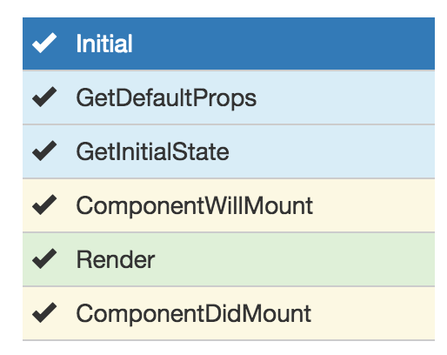
The Lifecycle - Initialization
Code and example here

Slide 15
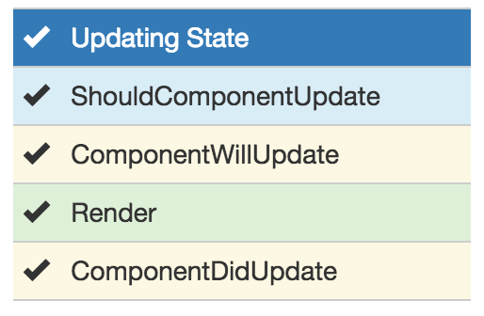
The Lifecycle - State Changes
Code and example here

Slide 16
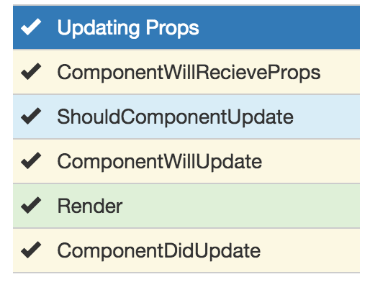
The Lifecycle - Props Changes
Code and example here

Slide 17
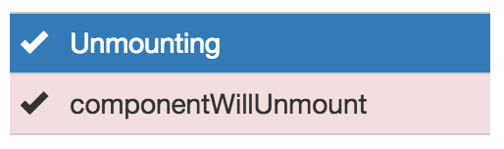
The Lifecycle - Unmounting
Code and example here

Slide 18
Pros & Cos of React.JS
THE GOOD POINTS:
THE BAD:
React.js is extremely efficient
- Virtual DOM
It makes writing Javascript easier
- React.js uses a special syntax called JSX
It gives you out-of-the-box developer tools
- React.js chrome extension
It’s awesome for SEO
UI Test Cases
React.js is only a view layer.
Integrating React.js into a traditional MVC framework would require some configuration
There is a learning curve for beginners who are new to web development.

Slide 19
Why you should use React.js:
React.js works great for teams, strongly enforcing UI and workflow patterns.
The user interface code is readable and maintainable.
And also, there is now a lot of demand for developers with ReactJS experience.

Slide 21

Demonstration
[Complete Demo]

Slide 22


Slide 23


